Slide 1


preferred partner

Slide 2
Types of Windows
WINDOW TYPE | SECTION
Casement | 62 mm series section , 2.2 mm thick
2 Track Slider | 62 mm series section, 2.2 mm thick
3 Track Slider | 112 mm series section, 2.2 mm thick
Multi track slider | 112 mm series section, 2.2 mm thick
Combination window | 50, 62, 112 mm series section, 2.2 mm thick
French window | 62 mm series section, 2.2 mm thick
Tilt & Turn | 62 mm series section, 2.2 mm thick
Fixed | 50 mm series section, 2.2 mm thick

Slide 3
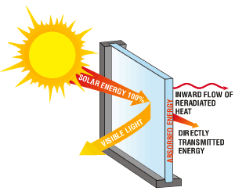
Minimum U Value
minimum energy loss.
Timber | Aluminium | uPVC
2.78 | 4.93 | 2.61
W/m2K
U-values is measured as the amount of heat lost through a one square meter of the material for every degree difference in temperature on either side of the material.
A double glazed window will be significantly better with a U-value of 2.8 i.e. only transmitting 2.8 watts of energy as compared to 5.6 watts in single glazing.
Notes:
The calculation of U-values can be rather complex - it is measured as the amount of heat lost through a one square
meter of the material for every degree difference in temperature either side of the material. It is indicated in units
of Watts per Meter Squared per Degree Kelvin or W/m2K. Note that Kelvin is used as the scale of temperature
difference, but this is numerically equal to oC. So for example, one square meter of a standard single glazed
window will transmit about 5.6 watts of energy for each degree difference either side of the window or a U-Value
of 5.6. A double glazed window will be significantly better with a U-value of 2.8 i.e. only transmitting 2.8 watts
of energy in similar conditions.

Slide 4
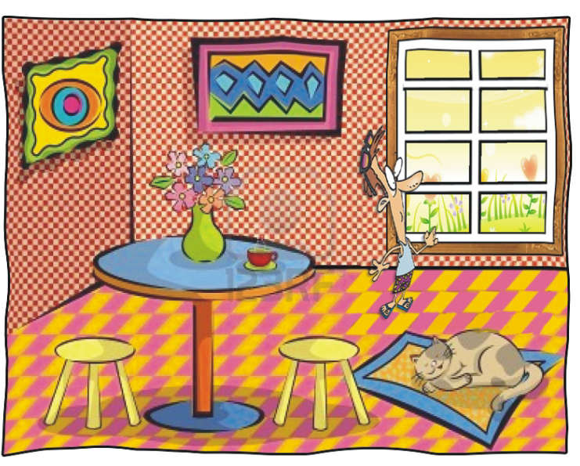
Aesthetics
Factory finished and standardized doors and windows
Available in white & photo finish colored lamination
Minimum human interface for standardized quality and finish

Slide 5
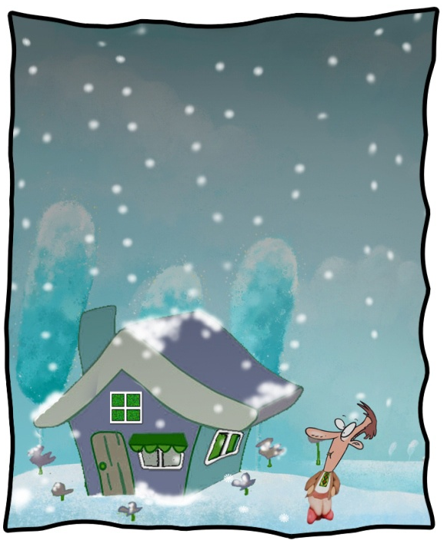
Weather Resistant
Profiles do not deteriorate even under extreme temperature or moisture
Additives like Titanium Oxide promotes opacity & resin protection against degradation due to ultraviolet light
Negligible water absorption valued at 0.05% is 50% less than the prescribed limit in uPVC

Slide 6
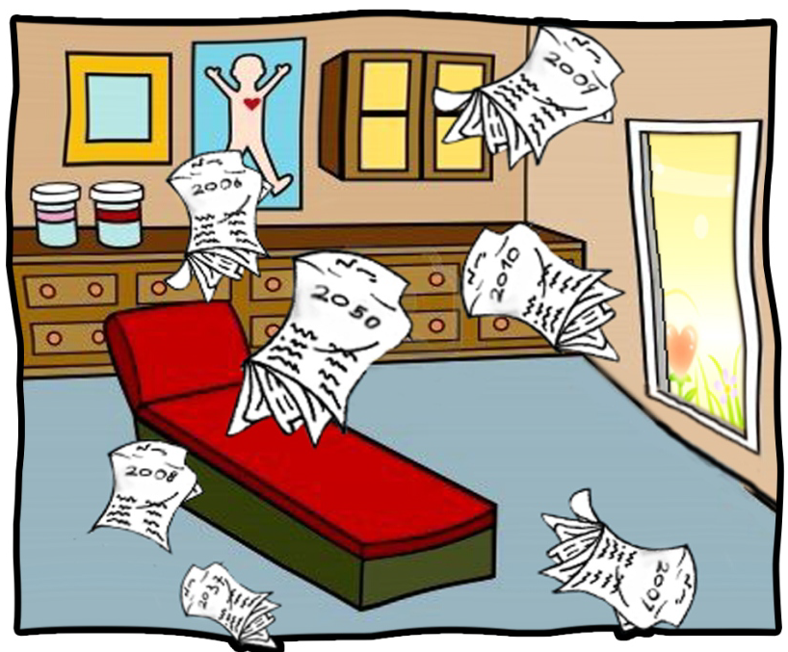
Long Life & Maintenance Free
No polishing
No painting
No dents
Drainage holes
Termite Resistant
Fungal Free
Pest Free
Chemical & corrosion resistant

Slide 7
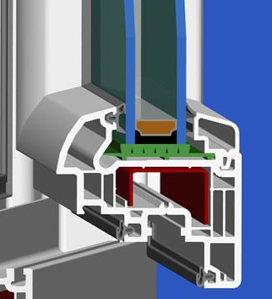
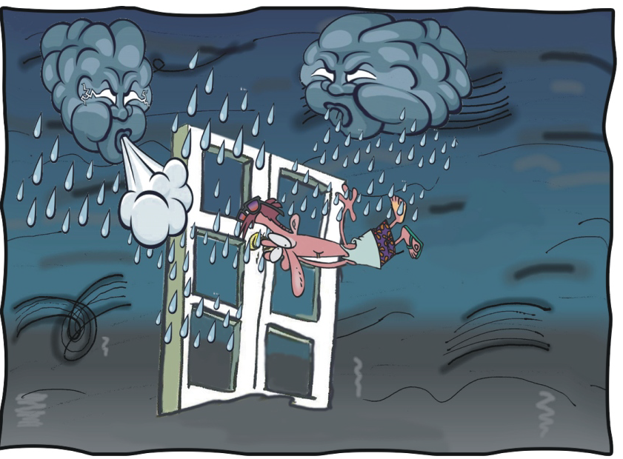
Maximum Wind Resistance
Insertion of Galvanized Iron reinforcement on all sides
Provides additional strength.
GI reinforcement increases as we install at higher floors
or in higher wind load areas

Slide 8
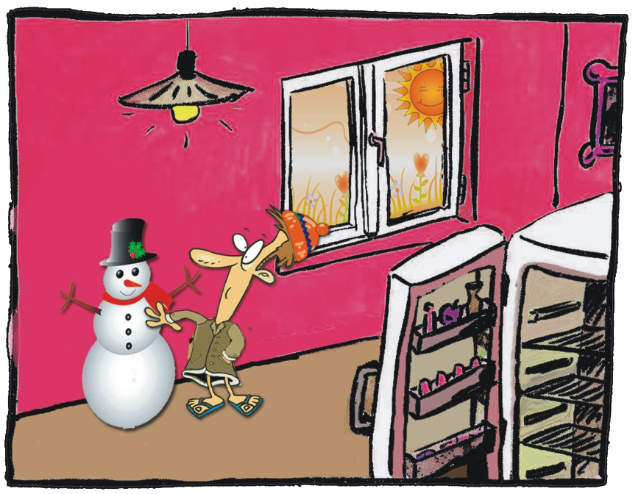
Thermal Conductivity
Wintrack profile has a low thermal conductivity, of 0.14kcal/m.hr°C
This is 1:1250 of Aluminium, which is 175 kcal/m.hr°C.
The lower the thermal conductivity the more the energy saving.
Wintrack uPVC Windows and Doors can therefore reduce the energy loss by 30%.
Multi chambered profile with tight seal are used to design Wintrack uPVC Windows and Doors.

Slide 9
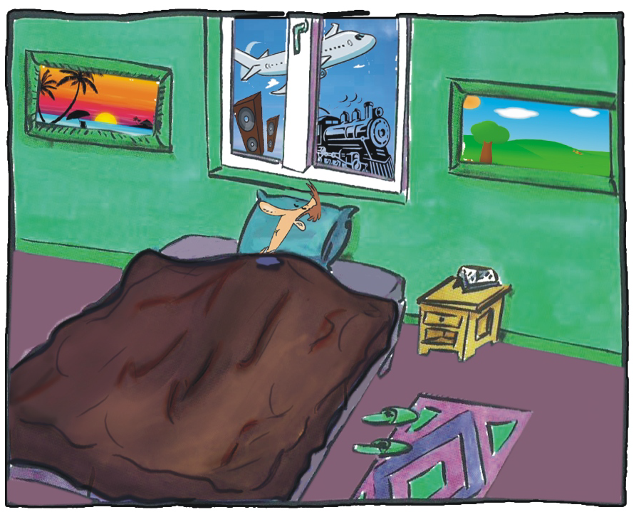
Sound Insulation
Wintrack windows and doors are fusion welded, locked at multiple points and double sealed leading to excellent sound insulation.
Use of sound proof design FPVC gaskets
No sound
No dust
No pollution
No water
Optional sound resistant can be incorporated with
Sound insulating glass

Slide 10
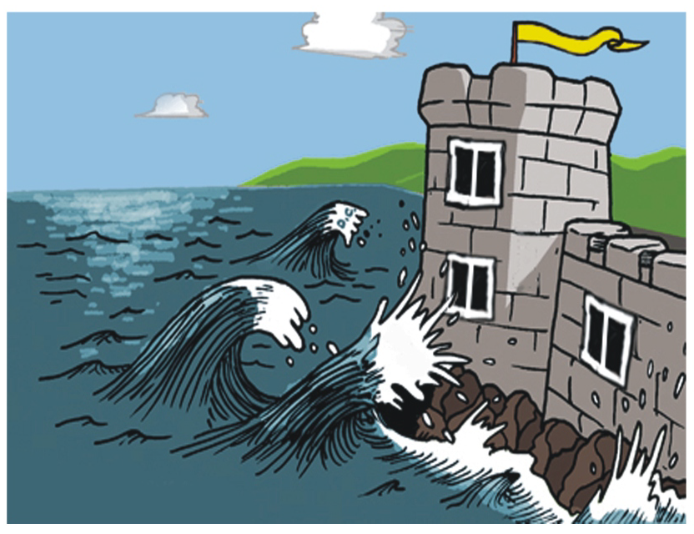
Maximum Water Tightness
Water drain mechanism prevents rainwater from flowing inwards.
Weep hole drains out accumulated water on the outer face of the window
Proper sizing and use of high
Quality silicon sealants between the sill and outer frame of windows ensures water tightness
Proper gaskets for glazing, made out of FPVC alloy which is 100% fungal free, long life and sound proof design

Slide 11
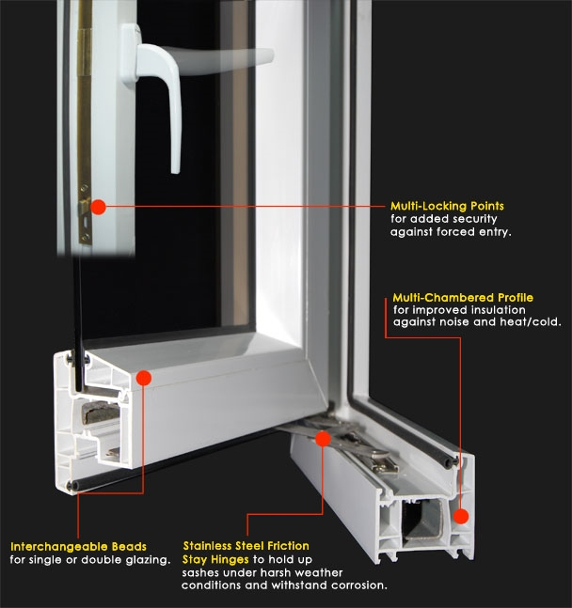
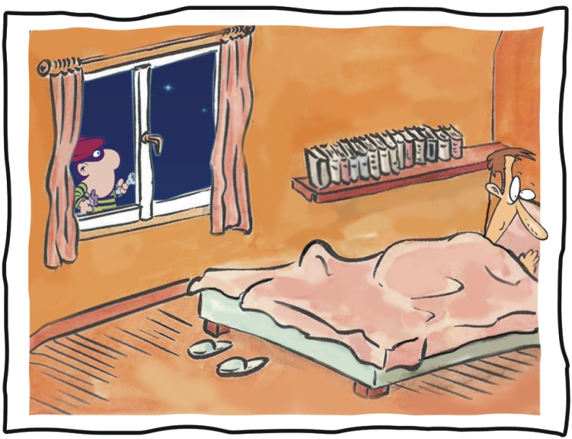
Protection against Burglary
Windows are internally beaded High quality multi locking systems

Slide 12
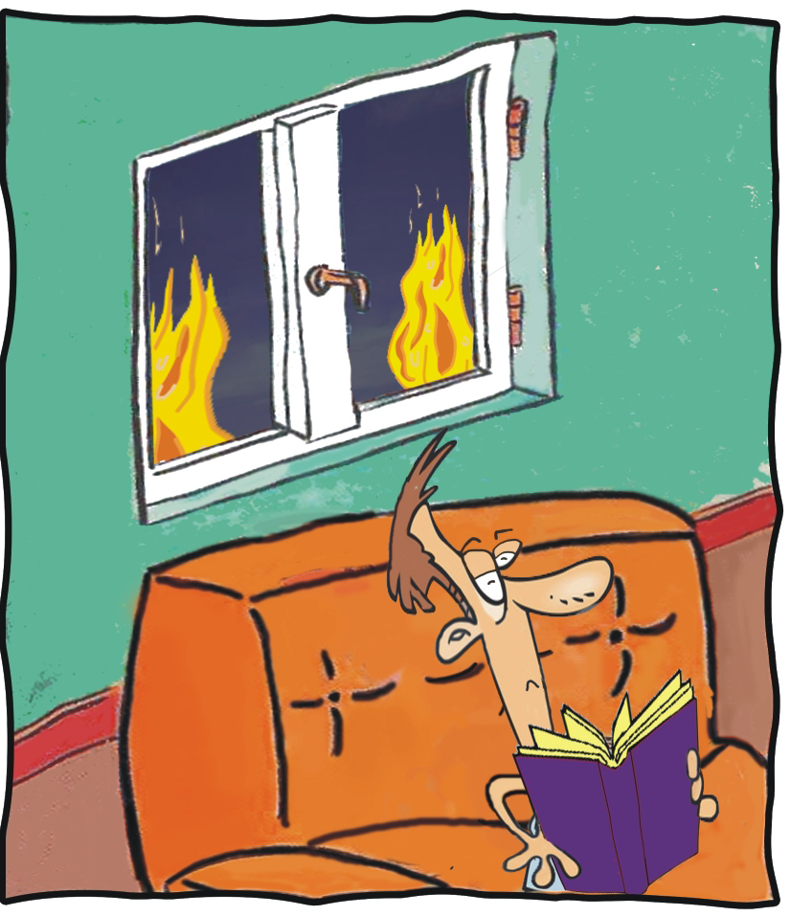
Fire Resistant
Wintrack uPVC profile will support flame only when % of oxygen is 44.8%.
Since the atmosphere contains only 21% oxygen our profiles cannot support fire.
Low intrinsic oil content

Slide 13
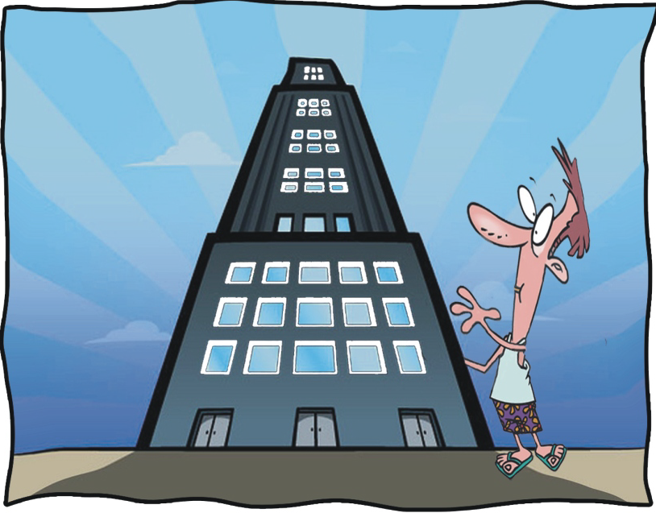
High Material & Structural Performance
Density : -
Low filler density (1.44. Calcium Carbonate) means higher strength.
Flexural modulus of elasticity :- force required for deformation of our profile under specified test condition . Standard value for this is >2200MPa. Our value is 2980MPa.
Vicat softening temperature: -
Temp at which 1.0mm needle penetration occurs. Our value is 83 degree C.
Impact Resistance : Profile can withstand impact even at -10deg C
Behaviour after heat aging :- No surface defects after heat aging at 150 deg C for 30+/-3 min.

Slide 14

Environment Friendly
100% recyclable and the longevity of the product makes it a very strong option to wood, which reduces deforestation considerably.
RoHS compliance test : - It checks the presence 6 banned metals (Pb, Hg, Cd, Cr+6, PBDE, PBB).

Slide 15
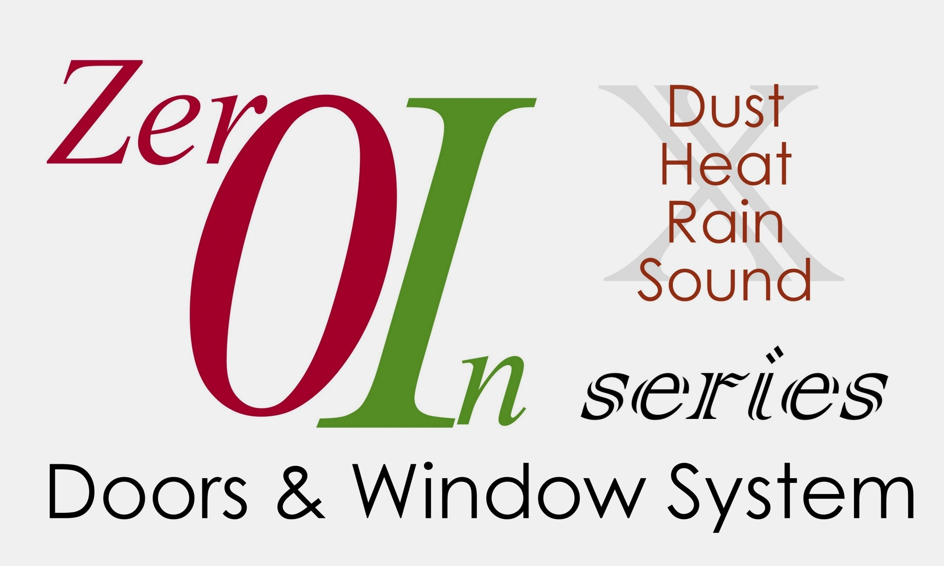
Premium series for
sound proof & energy efficient windows

Slide 16
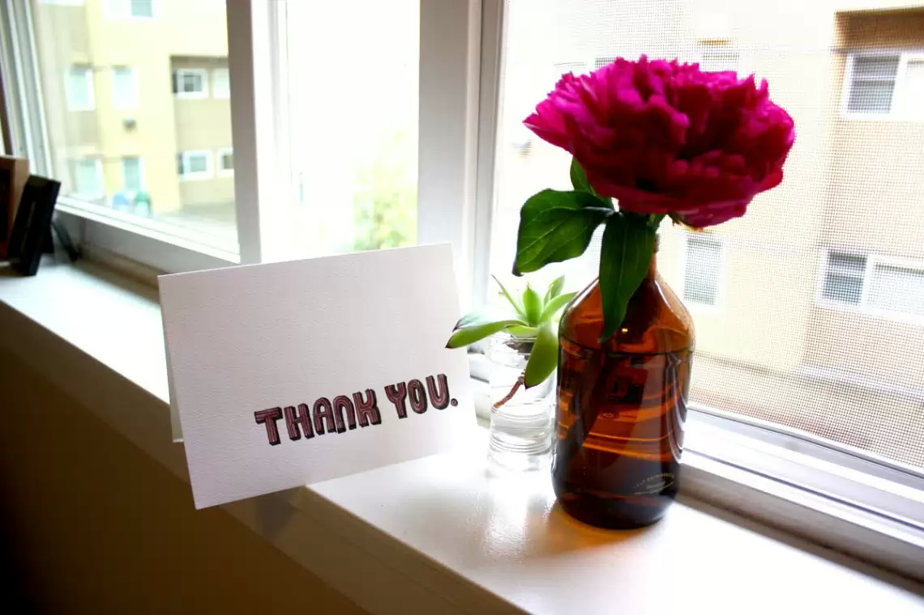
Partners

